Slide 1

Distinctions between managers, administrators, leaders
maker: Harry

Slide 2

01 Introduction
介绍
目 录
02 Differences and relationships
区别及关系
CONTENTS
03 Famous leader
领导人
04 To sum up
总结

Slide 3

manager
The manager is the person in charge of the company's daily operation management and administrative affairs. He has a good grasp of the company's business direction and the correct issuance of instructions in order to maximize the business goals
经理是公司的日常经营管理和行政事务的负责人，把握好公司业务方向以及正确的颁布指令，以期经营目标最大化

Slide 4

Administrative
Administrative director, it is to command and mobilize the internal affairs of the enterprise organization. It is one of the important components of the company. Cooperate with each unit to handle all daily affairs related to personnel affairs and obey the unified command of the general manager
行政主管，它是为对企业机构的内部事务进行指挥、调动，它是公司重要的组成部分之一.配合各单位处理与人事相关的一切日常事务，服从总经理的统一指挥

Slide 5

leader
The person who implements the guidance and influence is called the leader, and the person who receives the guidance and influence is called the leader. The leader is the soul of a company
实施指导和影响的人称为领导者，接受指导和影响的人称为领导者，领导者是一个公司的灵魂

Slide 6
grade
Leaders at the top of the company
领导者公司的最高层
The core of the manager company
经理是公司的核心
Important part of the executive company
行政主管是公司的重要组成部分

Slide 7


Managers and Administrative
Managers and executives are not the same. The executive is the key to the grassroots level. The executive is responsible for leading a team to be responsible for the performance of a professional field; while the manager is responsible for leading one or several teams to be responsible for the performance of a department
经理和行政主管是不一样的，行政主管是基层的关键，行政主管是负责带领一个团队负责一个专业领域的业绩；而经理要领导一支或几支团队负责一个部门的业绩

Slide 8
Managers and leader
The difference between a manager and a leader is that the focus of attention between the two is different. The manager pays attention to the inside, while the leader looks like the outside. They pay attention to the macro pattern
经理与领导人的区别在于两者的关注焦点不同，经理关注内部，而领导人他们是像外看的，他们关注宏观格局

Slide 9

relation chart
manages
leader
manages
administrators
manages

Slide 10
Famous Quotes Sharing
The manager does things right, the leader does the right thing
经理把事情做对 领导人做正确的事

Slide 11
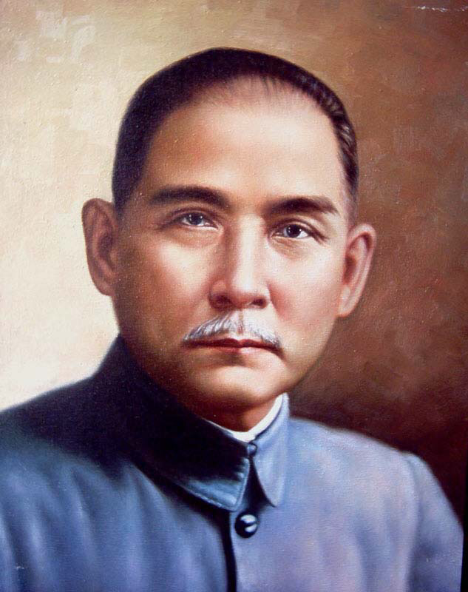
Famous leader
Sun Yat-sen's great leader, great national hero, patriot, great pioneer of China's democratic revolution, founder of the Republic of China and the Chinese Kuomintang, and advocate of the Three People's Principles, created the "Five Powers Constitution." He first held the banner of completely anti-imperialist and anti-feudal
孙中山伟大的领导者，伟大的民族英雄、爱国主义者、中国民主革命的伟大先驱，中华民国和中国国民党的缔造者，三民主义的倡导者，创立了《五权宪法》。他首举彻底反帝反封建的旗帜

Slide 12
As a great leader, Mr. Sun Yat-sen has a lot to learn from. To learn from Mr. Sun Yat-sen's diligent study, good thinking, and a life attitude of advancing with the times, he should be diligent, studious, diligent, enterprising, innovative, accurately grasp the characteristics of the times, and always stand The forefront of the times and the forefront of practice
孙中山先生作为伟大的领导人有很多值得我们学习的地方，学习孙中山先生勤学善思，与时俱进的人生态度们应当勤奋好学，孜孜以求，不断进取，勇于创新，准确把握时代特征，始终站在时代前列和实践前沿

Slide 13
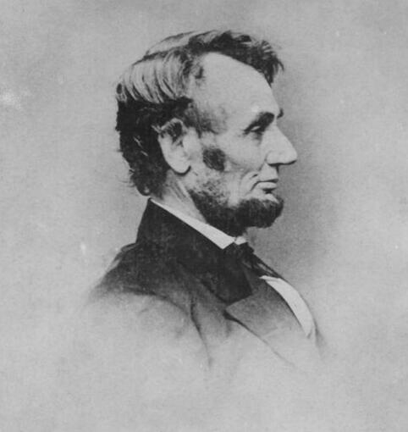
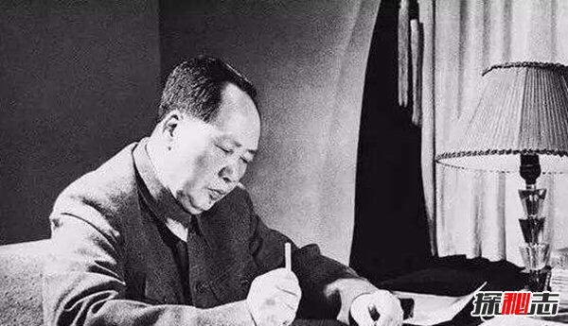
World famous leaders
China's great leader Mao Zedong
中国伟大领袖毛泽东
Famous American President Lincoln
美国著名总统林肯

Slide 14
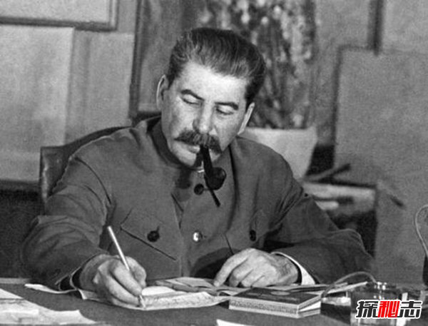
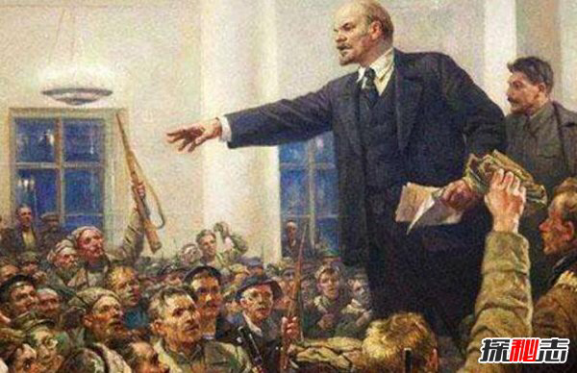
World famous leaders
Lenin, the teacher of the proletarian revolution
伟大的无产阶级革命导师列宁
Stalin, a great figure in the world anti-fascist war
世界反法西斯的伟大人物斯大林

Slide 15
last
Finally, we have to learn more from the spirit of leaders. Leaders become leaders not because of their identity, but because of what they are. They have a strong sense of responsibility, values ​​and attitude. Leaders have the right to assist team members in achieving their goals
最后我们从中要多学习领导人身上的精神，领导人之所以成其为领导者，不是因为他们的身份，而是因为他们的为人，他们有很强的责任感，价值观以及处事的态度。领导者具有权利，要多协助团队内部成员实现其目标

Slide 16
Thanks

